Slide 1
Plant Disease Classification
By
Jeswin Samuel Raj W
Notes:
1

Slide 2
Objective
To create a neural Network model which will classify based on the images provided by the camera whether the leaf is infected with a disease or not.

Slide 3
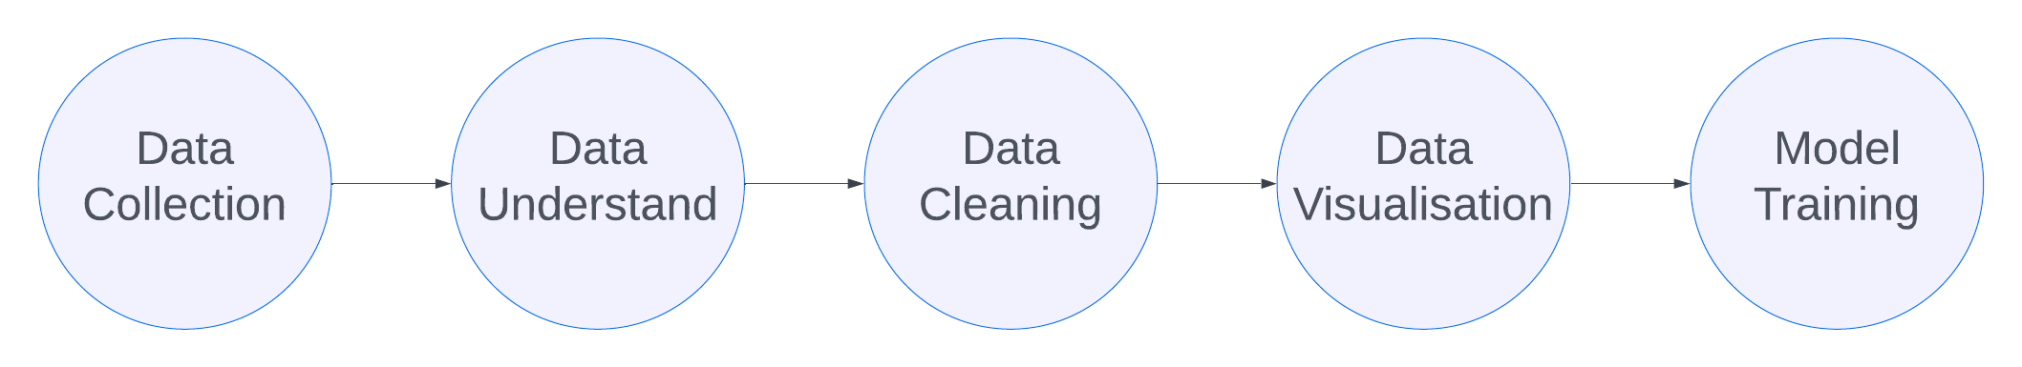
Approach to solve the problem
Notes:
3

Slide 4
Dataset Used
The dataset used in this model training are as follows :
New Plant Disease Dataset (Augmented) (https://www.kaggle.com/datasets/vipoooool/new-plant-diseases-dataset)
Plant Disease Recognisation (https://www.kaggle.com/datasets/rashikrahmanpritom/plant-disease-recognition-dataset?rvi=1)
Grape Vine Disease Dataset (https://www.kaggle.com/datasets/rm1000/grape-disease-dataset-original/data)

Slide 5
Understanding data
For our binary model, we need only two labels healthy and not healthy label data.
Dataset contains categorical disease prediction values so need to merge them together for easy model training

Slide 6
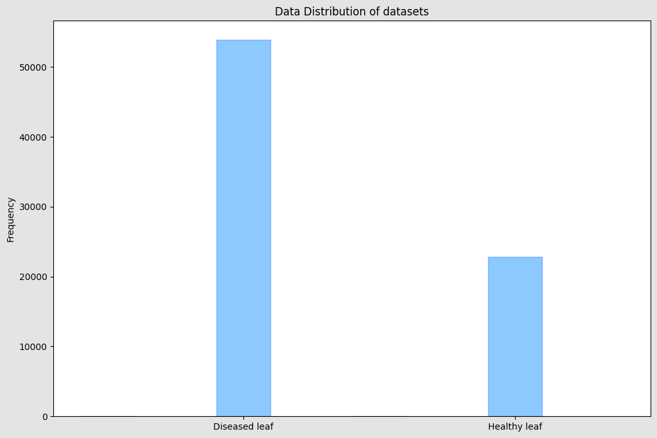
Data Visualization
Based on the histogram plot, we find that the data is imbalanced.
Notes:
6

Slide 7
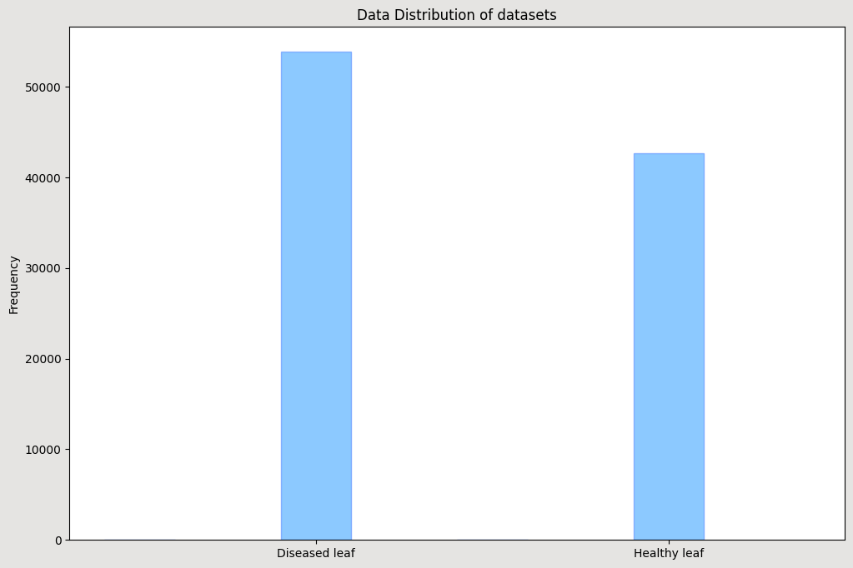
To balance the imbalanced dataset, image augmentation is done so that the data will be balanced.
Notes:
7

Slide 8
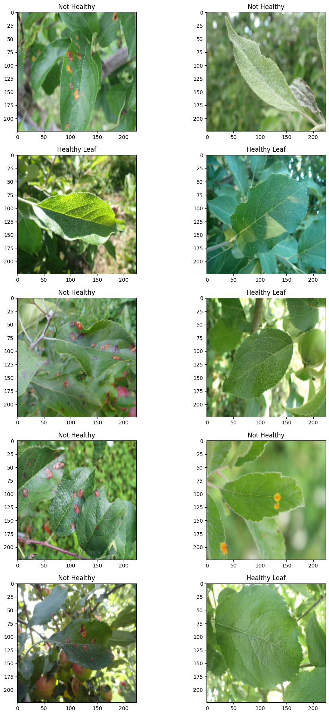
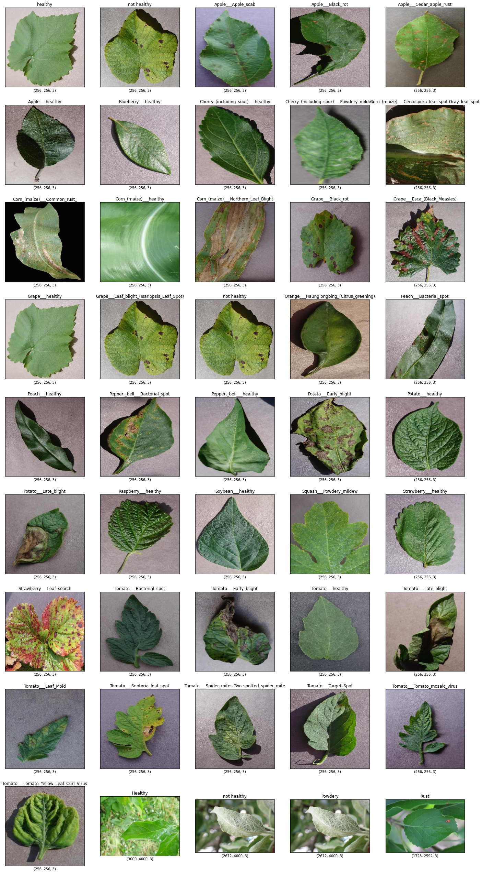
Dataset images
Notes:
8

Slide 9
Data cleaning
To balance the imbalanced dataset, image augmentation is done so that the data will be balanced.
The pixel size of the image for the dataset varies so they are converted to a fixed pixel size of (224,224,3) rgb image
Notes:
9

Slide 10
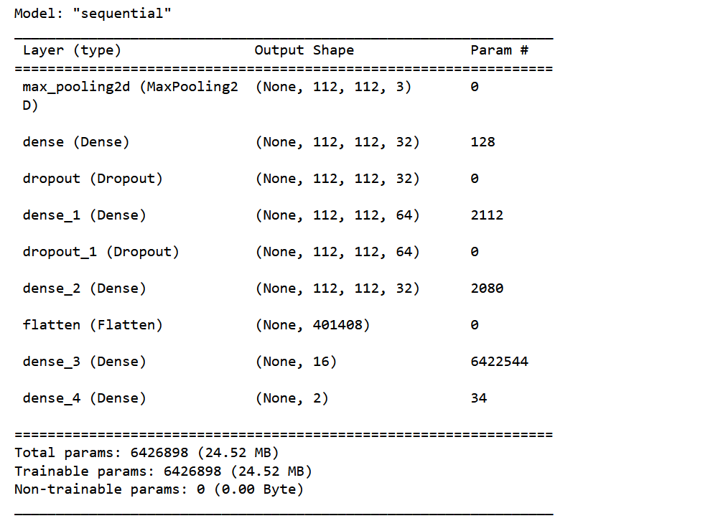
Model Summary
A simple Sequential neural network model which contains 5 layers is created with the following configuration
Notes:
10

Slide 11
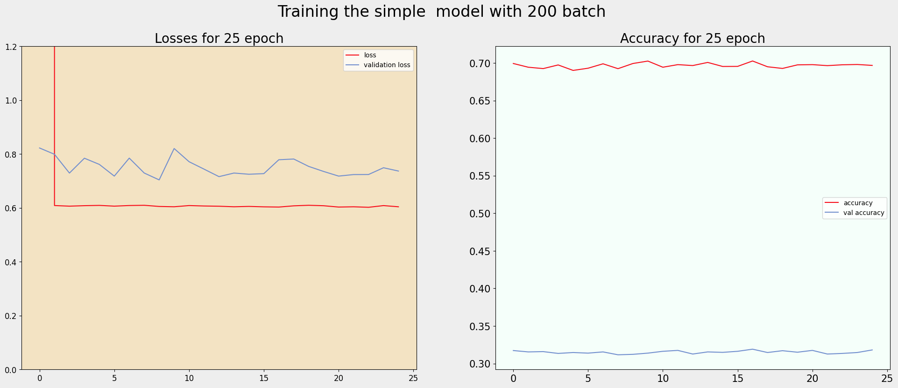
Model Training
After training the model for 25 epoch in batch size of 100 (each batch containing 100 images), the training loss and accuracy is as follows :
Based on the plots, we can see that the loss too high and accuracy of validation dataset is also less.

Slide 12
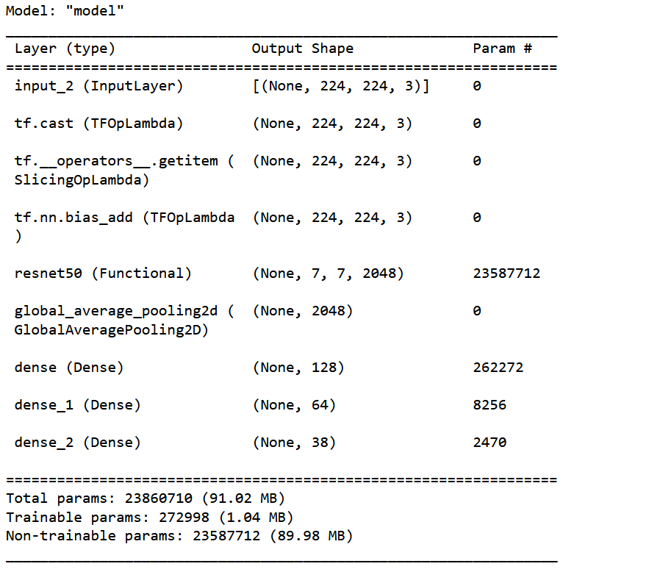
Pretrained Model Training
As using a simple neural network model cannot learn the pattern the dataset. I used a already trained RESNET model from Kaggle which is used for predicting 38 disease prediction in crops.

Slide 13
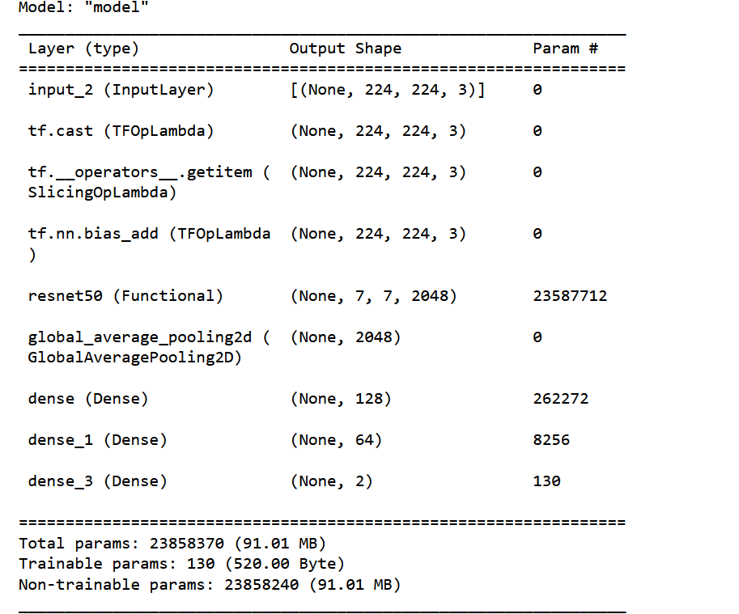
Model Tuning
As our objective is to find the crop health is good or bad based on the leaf photo, the model has been simplified such that it only predicts whether the plant is healthy or diseased.

Slide 14
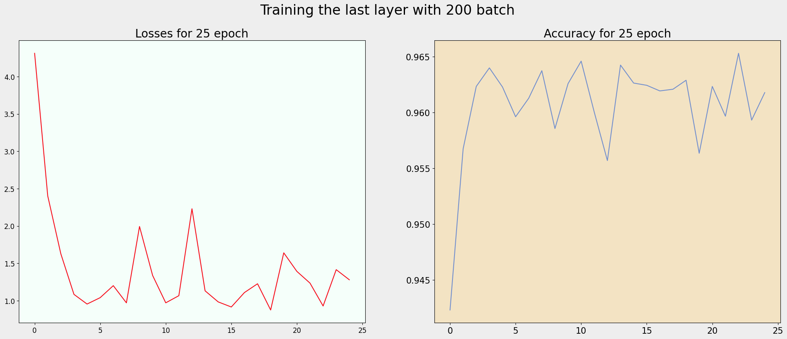
Training the last layer of model
As the model last layer has been changed, it is common practice to freeze all the remaining layers except the last layer so that the last layer can learn the pattern. Based on that, the following inference is found.

Slide 15
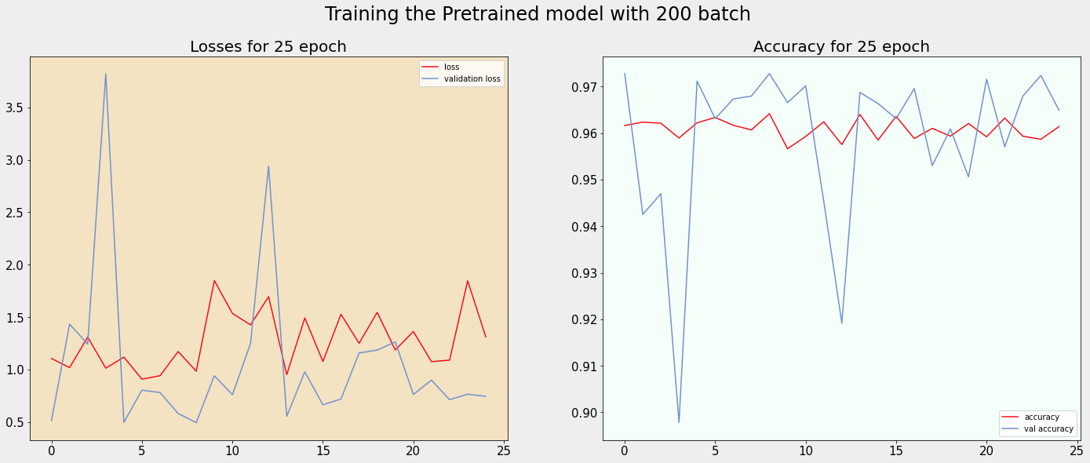
Training the entire model
The entire model is trained again with the train dataset and valid dataset and found the following data.

Slide 16
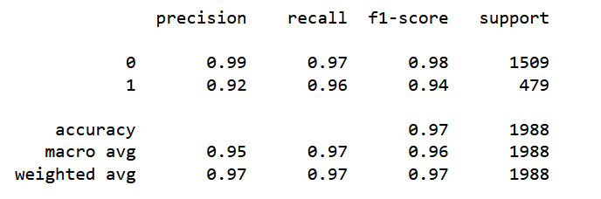
Results
The pretrained model gave a accuracy of 96.77% and loss value of 0.72 for the test dataset while the simple neural network model gave a accuracy of 24 % with loss of 0.75.
The tuned pretrained binary classification model gives a precision of 91.6 and recall of 96.45 and f1 score of 93

Slide 17
Inference
The model classify the plant or crop is healthy or not based on leaf image efficiently
The model can be further tuned such that the model is fed with real life data of plant photo instead of one leaf
After some further tuning, the model can be deployed in any autonomous vehicle which sprays pesticides which will contain a camera which will take video of crops while spraying pesticides to the crops so it will be prevent the disease from spreading to other crops.

Slide 18
References
https://www.kaggle.com/datasets/vipoooool/new-plant-diseases-dataset
https://www.kaggle.com/datasets/rashikrahmanpritom/plant-disease-recognition-dataset?rvi=1
https://www.kaggle.com/datasets/rm1000/grape-disease-dataset-original/data
https://cloudxlab.com/assessment/displayslide/5849/introduction?course_id=165&playlist_id=577
https://github.com/jeswinraj123/Project

Slide 19
Thank You

